Slide 1
Efficiency for Particle Systems
Dr. Jacob Moore
Associate Professor of Engineering
Penn State Mont Alto

Slide 2
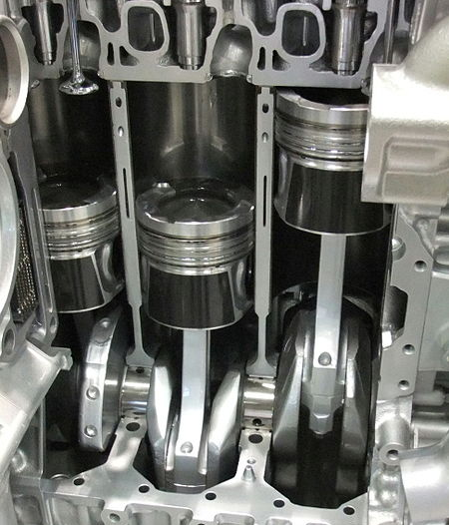
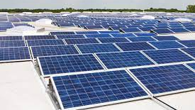
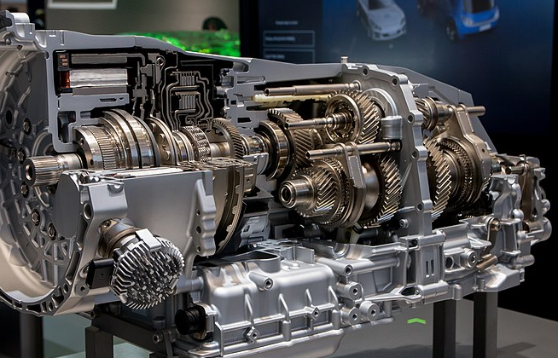
Work, Power, and Energy Transfer
Before we discuss efficiency, we need to discuss the concept of energy transfer.
Energy can’t be created or destroyed (first law of thermodynamics), but many engineering devices convert energy from one form to another. This is an energy transfer.
Image by AleSpa CC-BY-SA 3.0
Image by Johannes Maximilian
CC-BY-SA 4.0
Image by Mj-bird CC-BY-SA 3.0

Slide 3
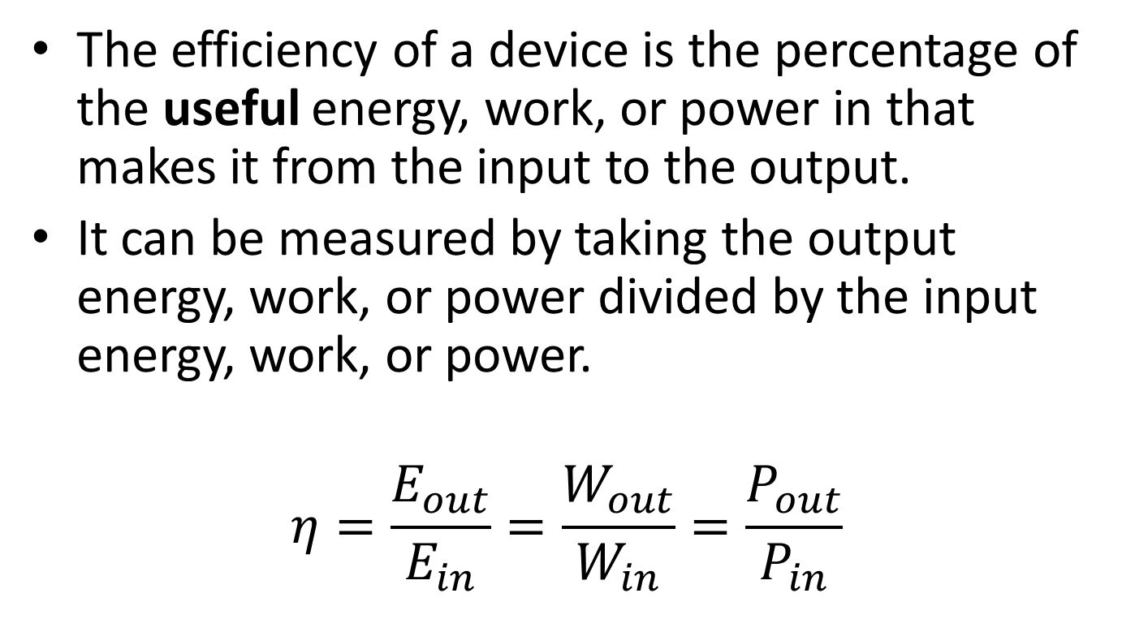
Efficiency
The efficiency of a device is the percentage of the useful energy, work, or power in that makes it from the input to the output.
It can be measured by taking the output energy, work, or power divided by the input energy, work, or power.
$$η=\frac{E_{out}}{E_{in}}=\frac{W_{out}}{W_{in}}=\frac{P_{out}}{P_{in}}$$

Slide 4
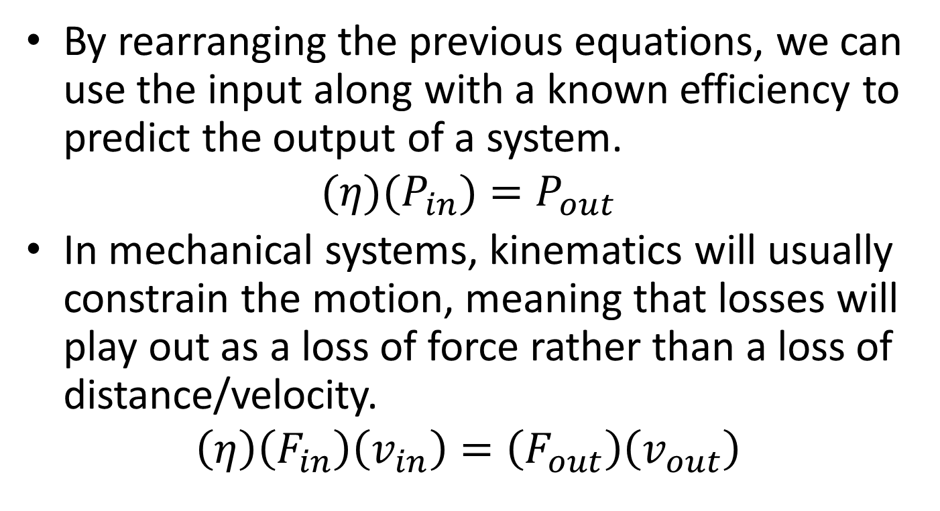
Efficiency
By rearranging the previous equations, we can use the input along with a known efficiency to predict the output of a system.
$$(η)(P_{in})=P_{out}$$
In mechanical systems, kinematics will usually constrain the motion, meaning that losses will play out as a loss of force rather than a loss of distance/velocity.
$$\left(η\right)\left(F_{in}\right)\left(v_{in}\right)=\left(F_{out}\right)\left(v_{out}\right)$$

Slide 5

Problems with Inefficiency
Since energy cannot be destroyed, the “lost” energy doesn’t really go away, it is just converted to a non-useful form, such as heat.
In some systems, this built-up heat can further decrease the efficiency, compounding the problem.

Slide 6
Thanks for Watching
See other engineering mechanics videos and access the full tool at…

Slide 7

Efficiency Worked Example
In a hydraulic system, a 6kN force is exerted over a 50 cm stroke length at the input piston. A 950N force is measured at the output over the 300cm stroke length. Based on these measurements, what is the efficiency of the hydraulic system?
Image by Cjp24 CC-BY-SA 3.0

Slide 8
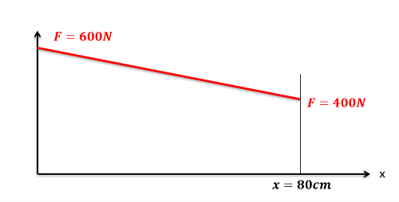
Efficiency Worked Example
A magnetic launch system exerts the force function shown below over its 80cm launch path. Assuming an 80% efficiency, what is the electrical energy we expect to have to put into the system to generate this force function?

